Slide 1

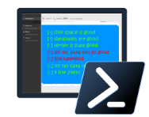


PowerShell Dream Team
Bringing it all together

Slide 2
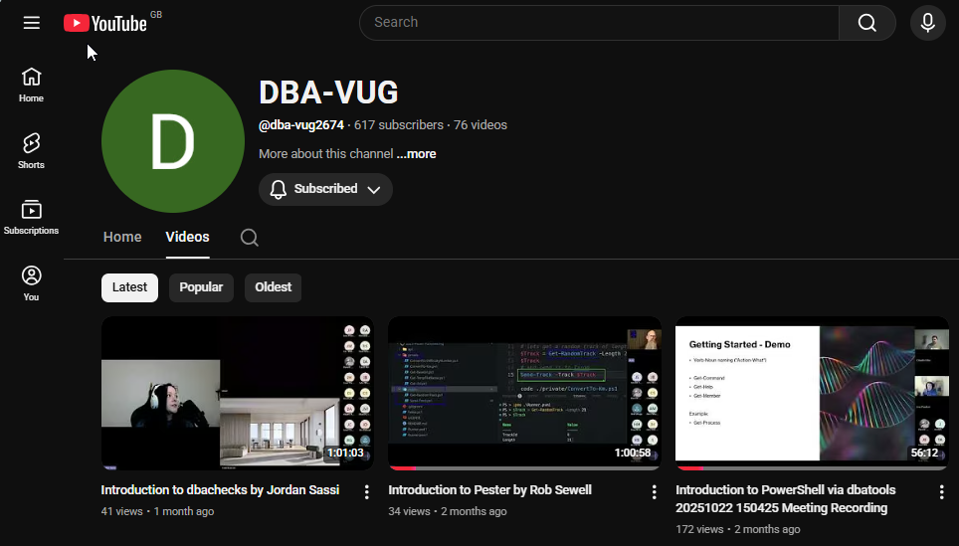
DBAVUG PowerShell Presentations
Sessions - github.com/JessAndRob/DBAVUG-PowerShell-Presentations
Oct 22nd - Introduction to PowerShell via dbatools - Jess & Cláudio
Nov 12th - Introduction to Pester - Rob
Dec 10th - Introduction to dbachecks - Jordan
Jan 28th - PowerShell Automation Magic 🪄 - dream team
https://www.meetup.com/dbavug/
https://www.youtube.com/@dba-vug2674
Notes:
Jess
- 4 sessions
- Different tools/levels
- Awesome sauce!

Slide 3
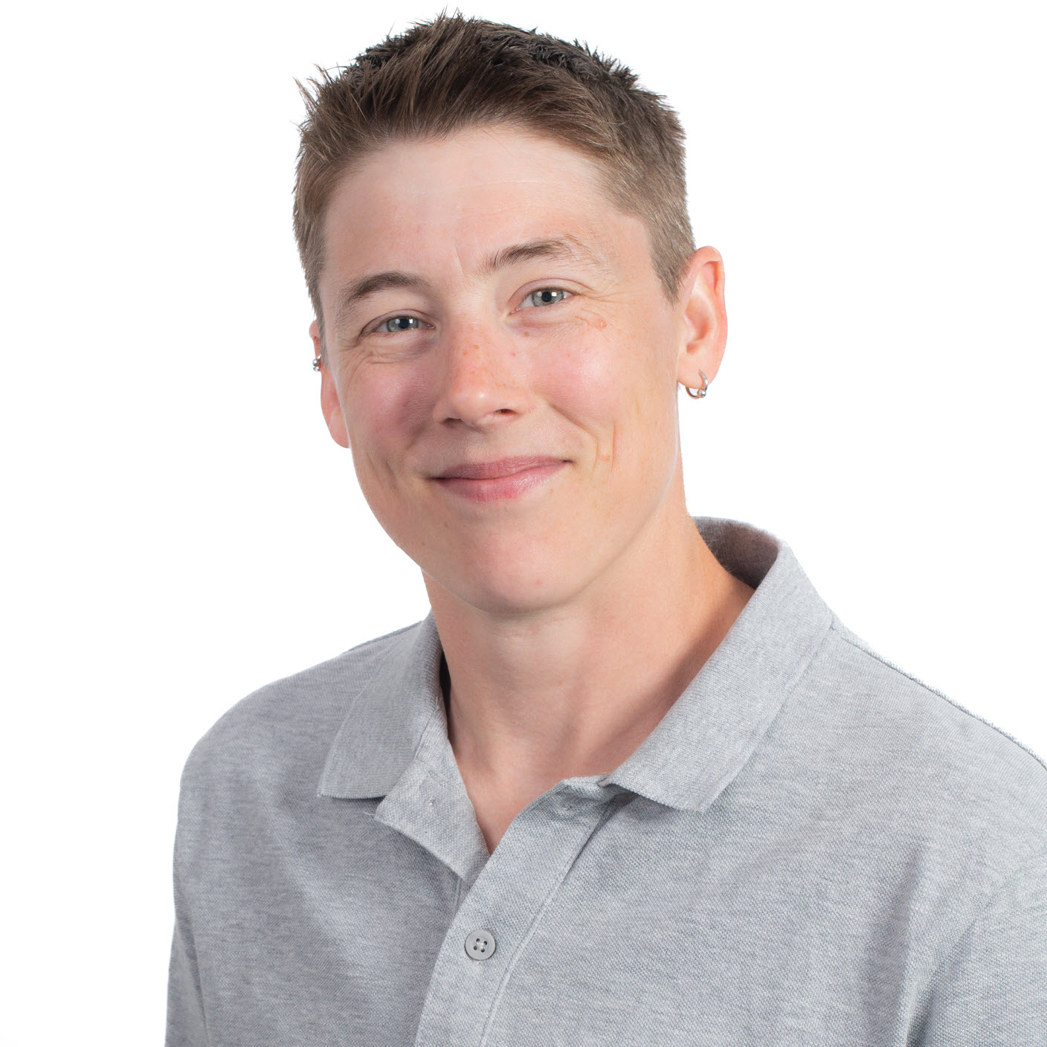


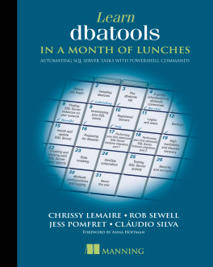


Jess Pomfret
(She / Her)
What do I do?
Database Administration
Automation
Open-Source Contributor
dbatools
dbachecks
jpomfret
jesspomfret.com
jpomfret
Notes:
Jess

Slide 4

Cláudio Silva
(He / Him)
What do I do?
Performance Tuning
Automation
Open-Source Contributor
dbatools
dbachecks
claudioessilva
claudioessilva.eu
claudioessilva
Notes:
Cláudio

Slide 5
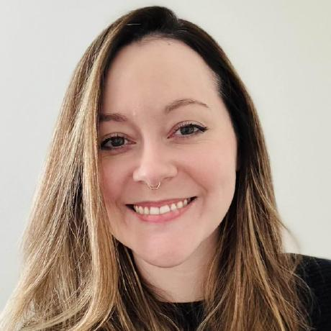


Jordan Sassi
(She / Her)
What do I do?
Database Administration
Automation
Open-Source Enthusiast
dbatools
dbachecks
jordansassi
jordansassi.com
SassiJ
Notes:
Cláudio

Slide 6
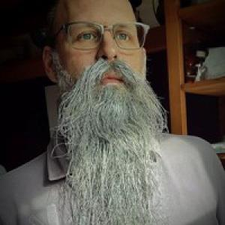
Rob Sewell
(He / Him)
What do I do?
Sewells Consulting LTD
Beard Twizzler
Open-Source Contributor
dbatools
dbachecks
robmsewell
Robsewell.com
SQLDBAWithABeard
Notes:
Cláudio

Slide 7
Agenda
🌐PowerShell Universal in action
Automated SQL Server configuration source control 📋
✅Disaster Recovery Readiness Check
PowerShell 💜 Fabric – MicrosoftFabricMgmt
Bring your questions!
This session is interactive and demo-heavy.

Slide 8


Slide 9
Resources
dbatools:
website - https://dbatools.io
Docs - https://docs.dbatools.io
GitHub - https://github.com/dataplat/dbatools
Slack - https://dbatools.io/slack/ - #dbatools channel
Book - Learn dbatools in a Month of Lunches
Other:
PowerShell Universal - https://www.powershelluniversal.com/
MicrosoftFabricMgmt - https://www.powershellgallery.com/packages/MicrosoftFabricMgmt/1.0.3
Blogs:
https://jesspomfret.com/
https://claudioessilva.eu/
https://blog.robsewell.com/
https://jordansassi.com
Notes:
Blog posts
Videos
Sessions on conferences

Slide 10
DBAVUG PowerShell Presentations
Sessions - github.com/JessAndRob/DBAVUG-PowerShell-Presentations
Oct 22nd - Introduction to PowerShell via dbatools - Jess & Cláudio
Nov 12th - Introduction to Pester - Rob
Dec 10th - Introduction to dbachecks - Jordan
Jan 28th - PowerShell Automation Magic 🪄 - dream team
https://www.meetup.com/dbavug/
https://www.youtube.com/@dba-vug2674
Notes:
Jess
- 4 sessions
- Different tools/levels
- Awesome sauce!

